Slide 1

HOUSE RENT PREDICTION ANALYSIS
Sucharitha Puppala
Data Science, Bellevue University.
DSC630-T302 Predictive Analytics (2231-1)
Professor Andrew Hua.
November 12,2022

Slide 2

Introduction
Rent refers to a regular payment made to a landlord by a tenant leasing property like a house or apartment.

Slide 3


Rental Market In India
Indian rental housing searches grew 84.4% in Q2 2022

Slide 4
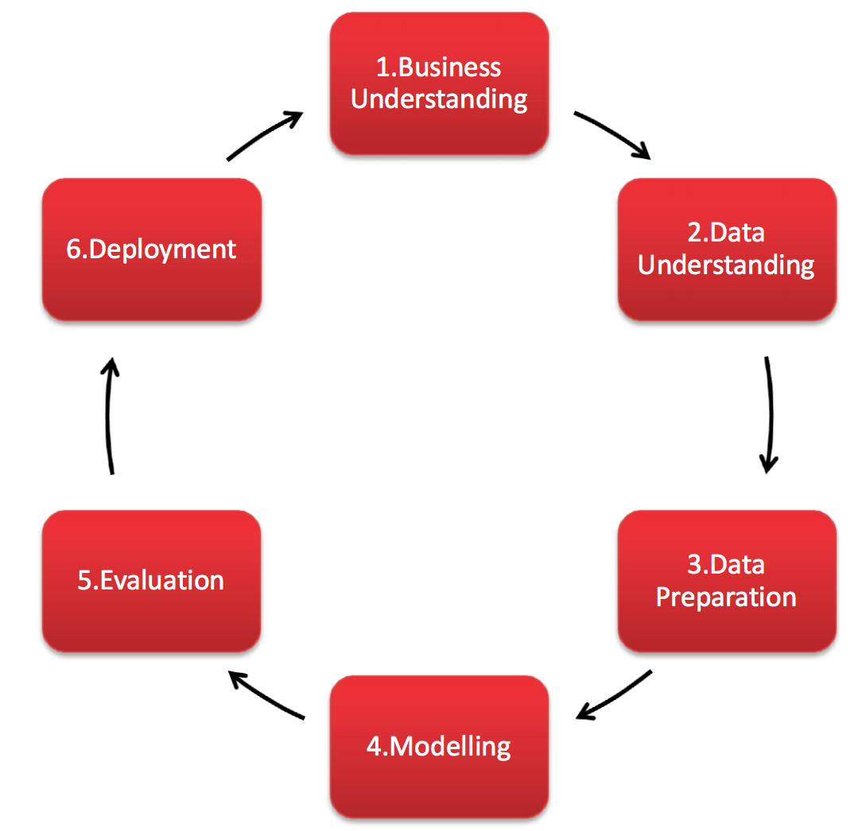
Methodology: CRISP - DM
CRISP-DM stands for cross-industry process for data mining. The CRISP-DM methodology provides a structured approach to planning a data mining project. It is a robust and well-proven methodology.

Slide 5
Business Understanding
The project main focus is on the factors that influence in prediction of rent around various locations of India. The analysis is done to
Identify the locations that are having more rental houses in India.
Identify the dataset features that are helpful in the prediction of house rent.
3. Identify the types of houses that are more preferred for renting in India.

Slide 6
Data Understanding 1. Dataset Source
“House Rent Prediction”
dataset from kaggle.com.
Contains the data of the houses available for rent in India.
We have information of almost 4700+ Houses/Apartments/Flats Available for Rent
Variables in the dataset
Posted on
BHK
Rent
Size
No. of Floors
Area Type
Area Locality
City
Furnishing Status
Type of Tenant Preferred
No. of Bathrooms
Point of Contact

Slide 7
Data Understanding 2. Overview of the dataset
Shape of dataset -> 4746 rows and 12 columns.
Dataset contains both numerical and categorical data.
The target variable is "Rent" .
There are no null values in the dataset.
The 'Floor' column is split into two columns i.e. 'Renting_Floor' and 'No_of_Floors' for clear understanding and Ground, Upper Basement and Lower Basement values that are in string are replaced with numerical values, like Ground = 0, Upper Basement = -1 and Lower Basement = -2 for easy analysis.
cont.…

Slide 8
Data Understanding 3.Data Exploration
For the exploratory data analysis the following visualizations are used.
Bar plots
Histograms
Boxplot
Pair plot
Heat map

Slide 9
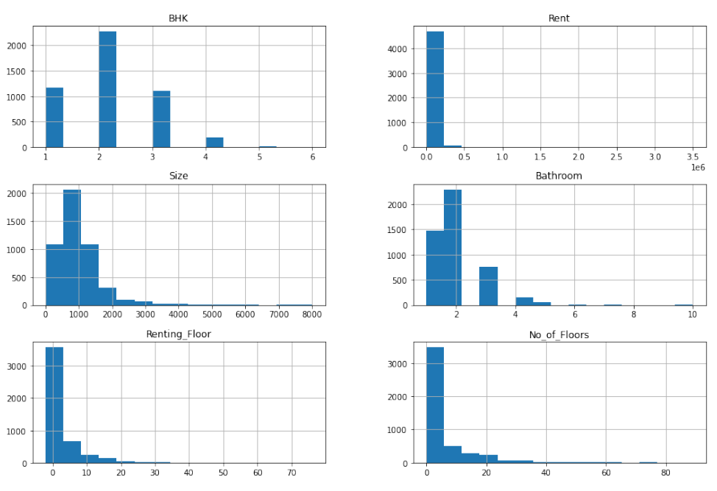
Data Understanding 3.Data Exploration
Histogram for the numerical variables in the dataset.

Slide 10
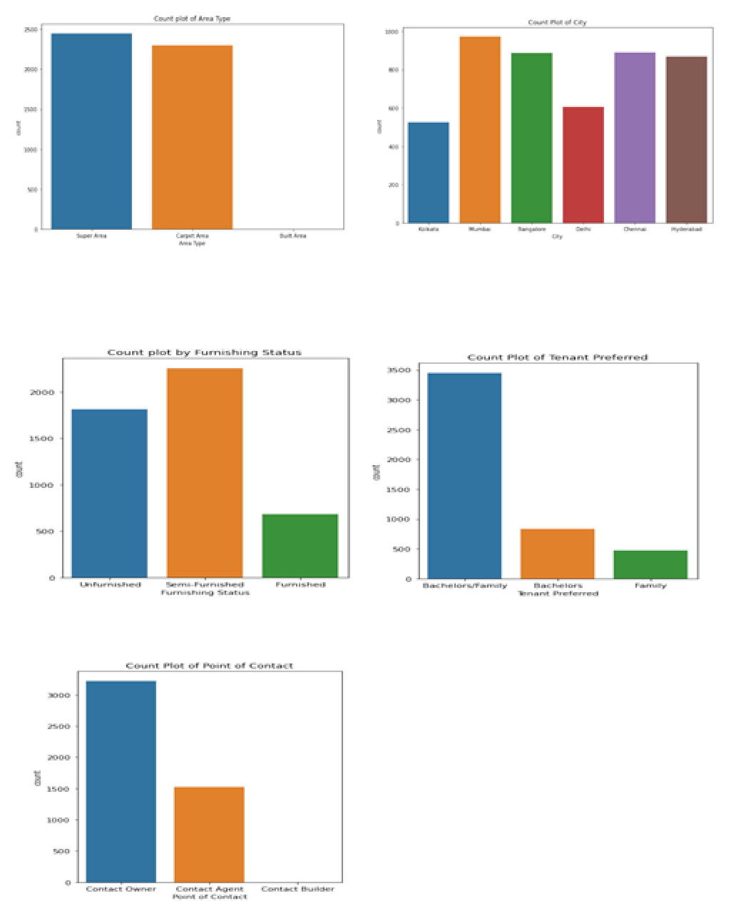
Data Understanding
Count plots for the categorical variables in the dataset.

Slide 11
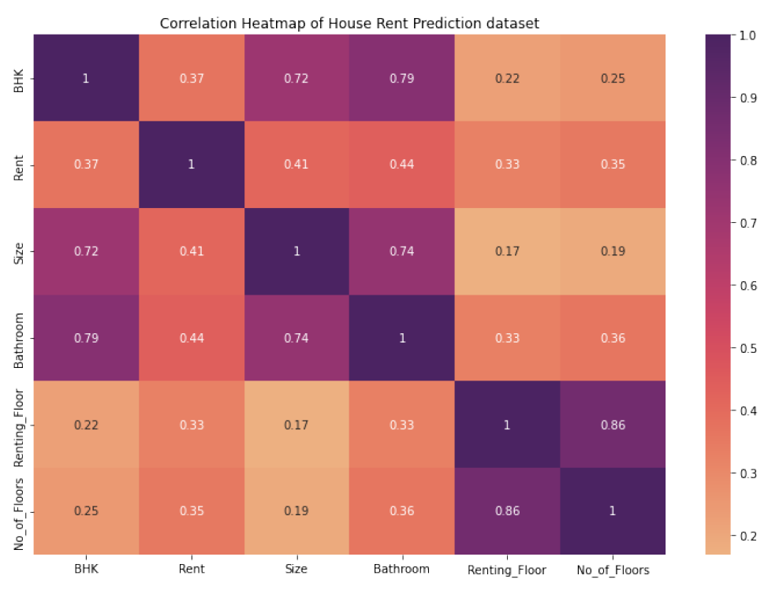
Data Understanding
Correlation heat map of the House Rent Prediction dataset

Slide 12
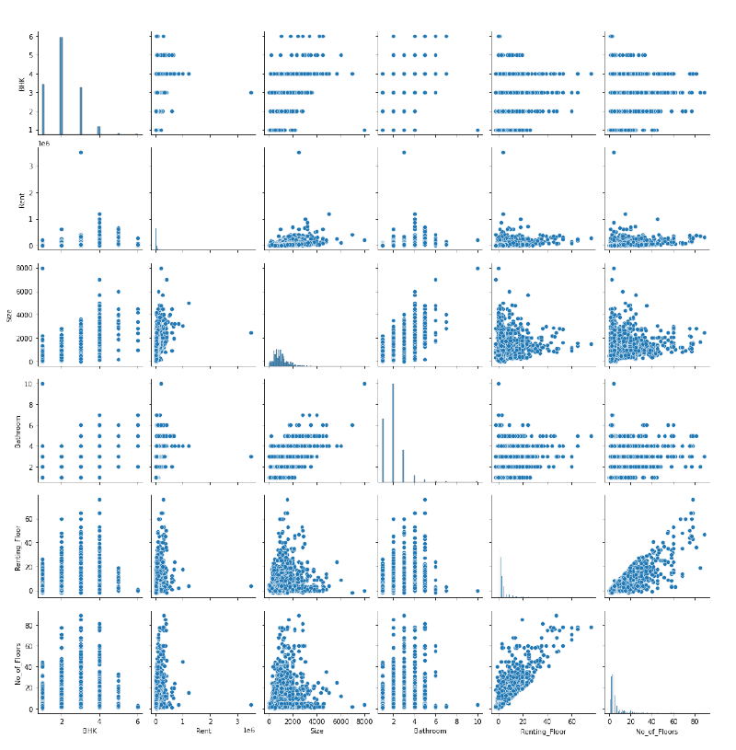
Data Understanding

Slide 13
Data Preparation
Process of pepping the data involved the following steps:
Removal of unnecessary columns from the dataset.
The columns 'Posted on', 'Floor', 'Area Locality' are dropped from the dataset.
After dropping the unwanted columns, check for null values and duplicate values is done. If any null values or duplicated values are identified those values are dropped and the shape of the dataset is identified.
cont.…..

Slide 14
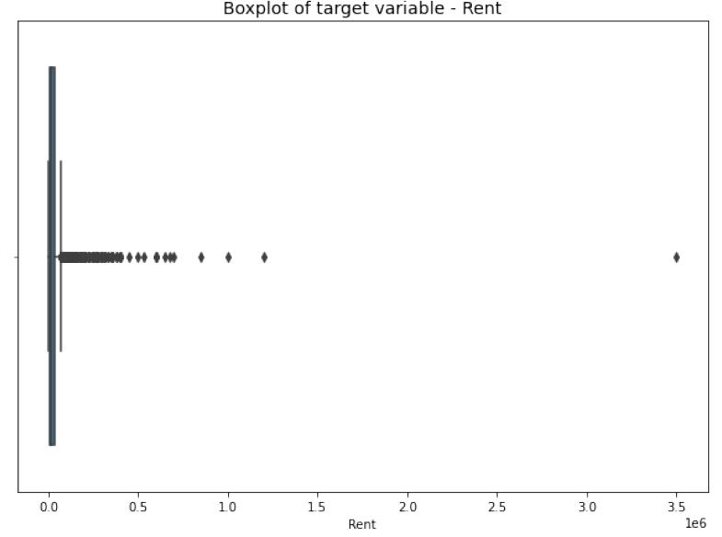
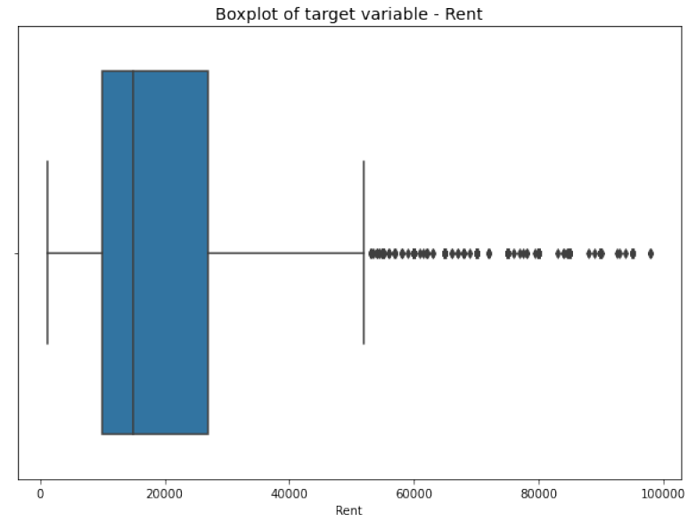
Data Preparation
Identification of the outliers and removal of the outliers.
a. Boxplot With Outliers b. After removal of outliers
cont.….

Slide 15
Data Preparation
Creating Dummy Variables for the Categorical Features
The categorical features present in the dataset are identified and dummy variables are created.
Check for null values is done and if any present are dropped from the dataset.
After that the shape of the dataset is obtained.
cont.……

Slide 16
Data Preparation
Split the dataset into ‘train’ and ‘test’ datasets.
Target variable - > ‘Rent’
The dataset is split into 80% training dataset and 20% test dataset, taking the test size as 0.2 and the random_state as 42.
The features train and test datasets are standardized using StandardScaler function.
The X_train dataset is transformed and fit to the standardscaler and the X_test dataset is just transformed but not fit.
With this the data is ready for model building.

Slide 17
Modeling
The problem addressed involves supervised learning with continuous target variable, the following models are selected for this project:
Linear Regression model
Decision Tree Model
Random Forest Regression Model
Least Absolute Shrinkage and Selection Operator (Lasso) Regression.
All the four models are created and fit with the X_train and y_train datasets respectively, predictions are created for the test dataset to evaluate the model’s performance

Slide 18
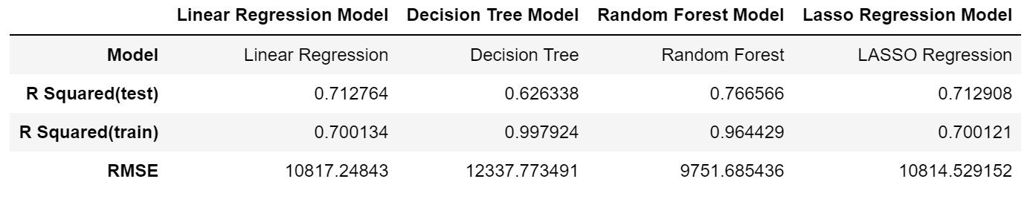
Evaluation
R Squared and RMSE (Root Mean Squared Error) are considered for model evaluation.
The evaluation metrics are calculated for each model respectively.

Slide 19
Linear regression Model
Performance of the Linear Regression model with the train and test datasets
R Squared (Test Dataset ): 0.7128
R Squared (Train Dataset ): 0.7001
MSE : 117012863.6065
RMSE : 10817.2484

Slide 20
Decision Tree Model
R Squared (Test Data ): 0.6263
R Squared (Train Data ): 0.9979
MSE value : 152220654.7231
RMSE value : 12337.7735
Performance of the Decision tree model with the train and test datasets.

Slide 21
Random Forest Regression Model
Performance of the Random Forest Regression Model with the train and test datasets.
R Squared (Test Data): 0.7666
R Squared (Train Data): 0.9644
MSE value : 95095368.8336
RMSE value : 9751.6854

Slide 22
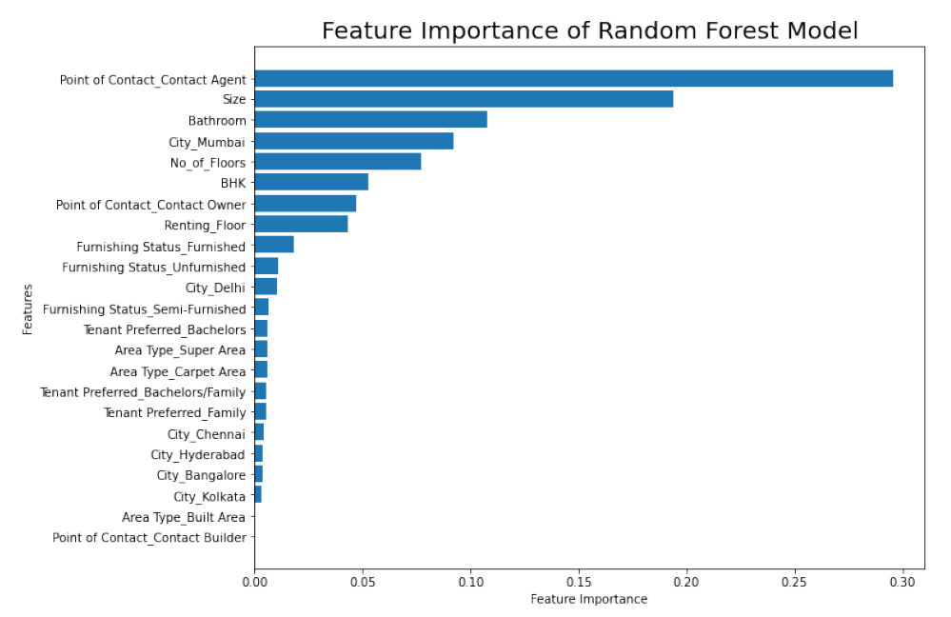
Feature importance in Random Forest Regression Model

Slide 23
Least Absolute Shrinkage and Selection Operator (Lasso) Regression Model
R Squared (Test Data): 0.7129
R Squared (Train Data): 0.7001
MSE value : 116954040.7728
RMSE value : 10814.5292
Performance of the LASSO Regression Model with the train and test datasets.

Slide 24
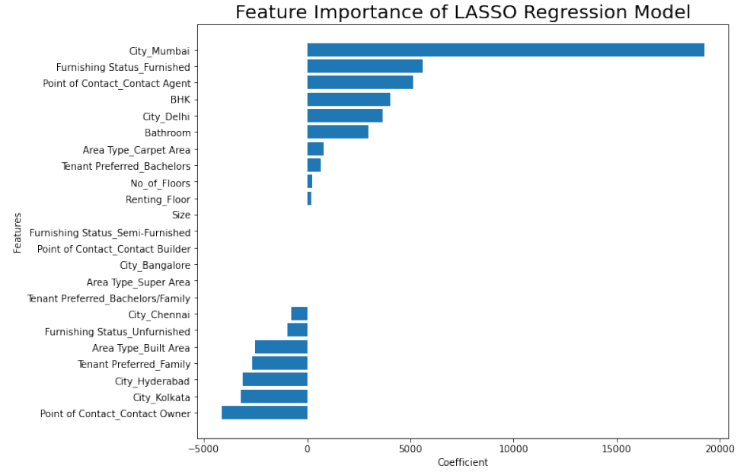
Feature importance in the LASSO Regression Model
Notes:
When observed the feature importance in the LASSO regression model – City Mumbai, Furnishing status- furnished, Point of contact by agent has more influence in predicting the house rent.

Slide 25
Deployment
Though the Random Forest performed well the model is not ready for deployment; however the features that are identified can be useful for the rental sites to concentrate on the identified area which can increase the usage of the site by the people in search of a rental house.

Slide 26
Recommendations
In future the project recommendations are; the project can be improved by applying the PCA (Principal Component Analysis), hyper parameter tuning on the models selected to reduce the problem of over fitting in the model and improve the performance of the model.
Cross-Validation technique can be used to assess how well a model performs on a new independent dataset.

Slide 27
Conclusion
As per the above analysis of the House Rent Dataset of India, we can say that in India the houses rents are mostly dependent upon the cities where the houses are situated, the number of Bedrooms, Hall and Kitchen available for houses, Bathroom available and Size of the house. This analysis will be helpful for the rental listing sites for contacting the owners of the rental properties available and updating the sites for easy access for the persons searching for rental houses, thereby increasing the business.

Slide 28
References
Google, ET Realty.com, Indian rental housing searches grew 84.4% in Q2 2022: Magicbricks, Aug 04, 2022 https://realty.economictimes.indiatimes.com/news/residential/indian-rental-housing-searches-grew-84-4-in-q2-2022-magicbricks/93351280
Google, Smart Vision Europe, What is CRISP-DM Methodology, https://www.sv-europe.com/crisp-dm-methodology/
Google, inria.github.io, scikitlearn, feature selectionhttps://inria.github.io/scikit-learn-mooc/python_scripts/dev_features_importance.html
Google, towardsdatascience , feature section in machine learning using lasso regression, https://towardsdatascience.com/feature-selection-in-machine-learning-using-lasso-regression-7809c7c2771a
Google, towardsdatascience, hyperparameter tuning in linear regression, https://medium.com/analytics-vidhya/hyperparameter-tuning-in-linear-regression-e0e0f1f968a1
Google, A Case Study of Evaluating Job Readiness with Data Mining Tools and CRISP-DM Methodology, https://infonomics-society.org/wp-content/uploads/iji/published-papers/volume-8-2015/A-Case-Study-of-Evaluating-Job-Readiness-with-Data-Mining-Tools-and-CRISP-DM-Methodology.pdf
Google, medium.com, PAIRPLOT VISUALIZATION, Sarath SL, Sep 29, 2019.https://medium.com/analytics-vidhya/pairplot-visualization-16325cd725e6#:~:text=Pair%20plot%20is%20used%20to,separation%20in%20our%20data%2Dset.
Google, businesswire.com, India Rental Housing Markets, Competition, Forecast & Opportunities, FY2027 - ResearchAndMarkets.com https://www.businesswire.com/news/home/20211027005747/en/India-Rental-Housing-Markets-Competition-Forecast-Opportunities-FY2027---ResearchAndMarkets.com

Slide 29
Thank You

